Slide 1
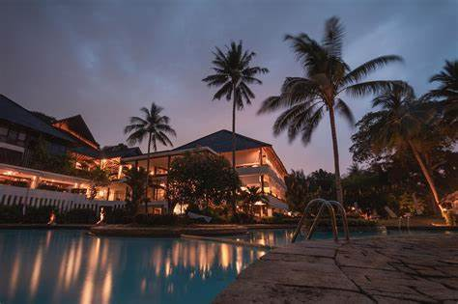
FutureTale Hotel Reservation

Slide 2

Introduction
In an era where data-driven decision-making is pivotal to success, understanding the intricate details of reservation patterns and guest behavior plays a crucial role in shaping the future of the hotel industry.
Future Tale Hotel speaks dynamic modernity. The Chinese Restaurant, Japanese Gourmet Restaurant, Lobby Lounge & Bars, and Grand Ballroom, as well as the guest rooms and suites, meet the most exacting comfort and service standards
Future Tale hotel has noticed inconsistencies in their returns from 2017 to 2018. Being a modern relaxation center with a booking platform, A significant number of hotel reservations are called-off due to cancellations or no-shows. The typical reasons for cancellations include change of plans, scheduling conflicts etc.
Importantly, my ability to comprehend the reasons behind reservation cancellations is paramount. By dissecting this data, I unearth valuable information that empowers us to enhance our booking policies, optimize revenue streams, and deliver an experience that not only meets but exceeds the expectations of our discerning guests.

Slide 3



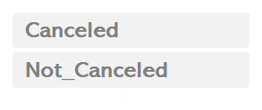

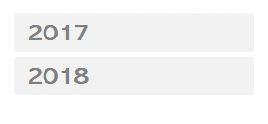
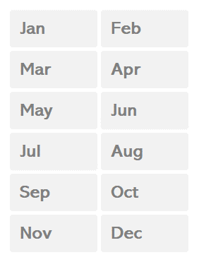
Total Trips
FutureTale Hotel Booking Cancellation
Dashboard 2017 - 2018
From 2017 to 2018. this analysis unraveled an additional 22% increase in booking cancellations with a corresponding decline im the redeemed bookings of clients at future Tale
=
Redeemed Bookings
Cancellation of Bookings
Total Bookings
67%
33%
36,275
o
% Cancelation Rate across the meal plan type, with meal plan 1 having the most bookings for both years
Year
Month
% Cancelation Rate across Room types reserved with room type 1 having most bookings for both year. And a 20% increase in cancelation from previous year
% Cancelation Rate across Market segment, with online channel Plan 1 having the most Bookings for both year

Slide 4
Overall Booking and Cancellation Analysis:
The analysis reveals that out of a total of 36,275 bookings, 33% were canceled, indicating a very high proportion of reservations being cancelled.
On a positive note, 67% of the bookings were successfully redeemed, highlighting a substantial portion of fulfilled reservations.
These metrics provide valuable insights into the booking dynamics, allowing for a comprehensive understanding of the reservation outcomes."

Slide 5
Cancelation trend for the period in view
In the year 2017, the hotel recorded a total of 6,514 bookings, demonstrating a cancelation rate of 15% and a redemption rate of 85%.
As we move to the year 2018, the total bookings increased to 29,761 but the cancellation rate also saw a rise to 37% resulting in redemption rate of 63%.

Slide 6
Meal Plan Impacts
The analysis of cancellation rates across different meal plan types reveals distinct patterns.
Meal Plan 1 consistently secured the highest number of bookings for both years, showcasing its popularity among guests.
However, Meal Plan 2, while attracting a substantial number of bookings, experienced the highest cancellation rate overall, surpassing even Meal Plan 1 in cancellation frequency.
These findings emphasize the importance of understanding the guest’s behavior associated with meal plans, suggesting potential areas for targeted interventions to improve booking stability

Slide 7
Room Type Analysis
Room Type 1 consistently attracts the most bookings for both years, underscoring its popularity among guests.
However, Room Type 6 exhibits the highest cancellation rate, signaling a noteworthy trend in reservation dynamics.
These insights highlight the significance of understanding guest preferences and behavior associated with specific room types, providing valuable input for strategic decisions to optimize booking stability."

Slide 8
Market Segment Analysis
The online market segment emerges with both the highest booking volume and cancellation rate, suggesting a need for targeted strategies to improve booking stability within this segment.
Conversely, the complementary market segment, while having the lowest booking count, showcases an impressive 0% cancellation rate, underscoring the effectiveness of current practices in securing reservations from this segment

Slide 9
Recommendation
Package Deals: Develop enticing package deals that include meal plans, aiming to increase the overall value proposition for guests. Consider offering flexible meal plan options to cater to different guest preferences.
Promotional Campaigns: Launch targeted promotional campaigns highlighting the benefits of booking packages with meal plans, emphasizing the added value and convenience for guests.
Review Room Type Policies: Evaluate the cancellation policies for room types with increased cancellation rates. If possible, adjust policies to make them more guest-friendly while ensuring operational feasibility.
Dynamic Pricing: Implement dynamic pricing strategies to adjust room rates based on demand, seasonality, and booking trends. Offering competitive rates during periods with historically lower cancellations may encourage more reservations.
Diversification: Explore opportunities to diversify the guest base by tapping into segments with historically lower cancellation rates. Consider partnerships or collaborations to attract a more stable clients. Tailor marketing and promotional strategies to target high-cancellation segments with personalized offers, loyalty programs, or exclusive deals.

Slide 10
Recommendation Cont’d
Streamline Booking Process: Enhance the online booking experience to make it user-friendly and efficient since it has the highest booking. Simplify the reservation process, and ensure transparency in terms of policies and fees to minimize uncertainties that may lead to cancellations.
Guest Feedback Analysis: Analyze guest feedback and reviews to identify specific pain points leading to cancellations. Addressing these concerns, whether related to service, amenities, or policies, can contribute to improved guest satisfaction and reduced cancellations.
Continuous Monitoring: Implement a robust system for continuous monitoring of booking patterns, cancellations, and guest behavior. Regularly analyze data to identify emerging trends and make informed adjustments to strategies.

Slide 11
THANK YOU

